Slide 1
NLP

Slide 2
Introduction to NLP
Morphology and the Lexicon

Slide 3
Mental Lexicon
What is the meaning of cat?
Its pronunciation?
Part of speech?
What is the meaning of wug?
What is the meaning of cluvious?
Compare traftful and traftless.
Morphology of these words
Intuition and productivity
“Runs”
Two interpretations
Allomorphs
cats/oxen, played/swung
Affixes

Slide 4
Derivational Morphology
Example
“er” (multiple interpretations)
What do these morphemes mean?
prefix, stem, suffix, ending
ness, able, ing, re, un, er (adj)
JJ → V + “-able”
Recursion:
unconcernednesses
Ambiguity
uncloggable vs. unbelievable
JJ
V
-able
drink

Slide 5
Answer to the Quiz
Uncloggable
unable to be clogged
able to be unclogged
Unbelievable
unable to be believed
? able to be unbelieved

Slide 6
Morphological Examples
Reduplication
amigo = friend, amimígo = friends (in Pangasinan) [Rubino 2001]
savali = he travels, savavali = they travel (in Samoan)
Templatic morphology (e.g., Semitic languages):
lmd (learn), lamad (he studied), limed (he taught), lumad (he was taught)
Circumfixes
spielen – gespielt (in German)
Pig Latin
appyhay
Verlan
“céfran”, “ripou” (from “l’envers”, “Français”, “pourri”)
Massa-freakin’-chusetts
where can you insert “freakin’” in “education”?

Slide 7
Answer to the Quiz
The “freakin’” infix is inserted
… to the left of the syllable that bears the main stress
edu-freakin’-cation
* educa-freakin’-tion
* e-freakin’-ducation
though there can be exceptions

Slide 8
More Examples
Clitics
l’enfant, cat’s cradle
Portmanteau words
motel, brunch, spork
Synthetic vs. isolating languages
Isolating languages (typically with fixed word order): English, Chinese, Bulgarian, Thai
Synthetic languages (high morpheme-per-word ratio): Inuktitut, Ainu, Basque, Lakota
Fusional vs. agglutinative languages
Agglutinative: Turkish, Hungarian, Swahili
Fusional: Lithuanian, Hebrew, Latin

Slide 9
Inflectional Morphology
Many forms
Tense, number, person, mood, aspect
Five verb forms in English
40+ forms in French
Six cases in Russian: http://www.departments.bucknell.edu/russian/language/case.html
Up to 40,000 forms in Turkish
E.g., you cause X to cause Y to … do Z)

Slide 10
Morphological Analysis
sleeps = sleep + V + 3P + SG
done = do + V + PP
Notes:
Check provenance!!

Slide 11
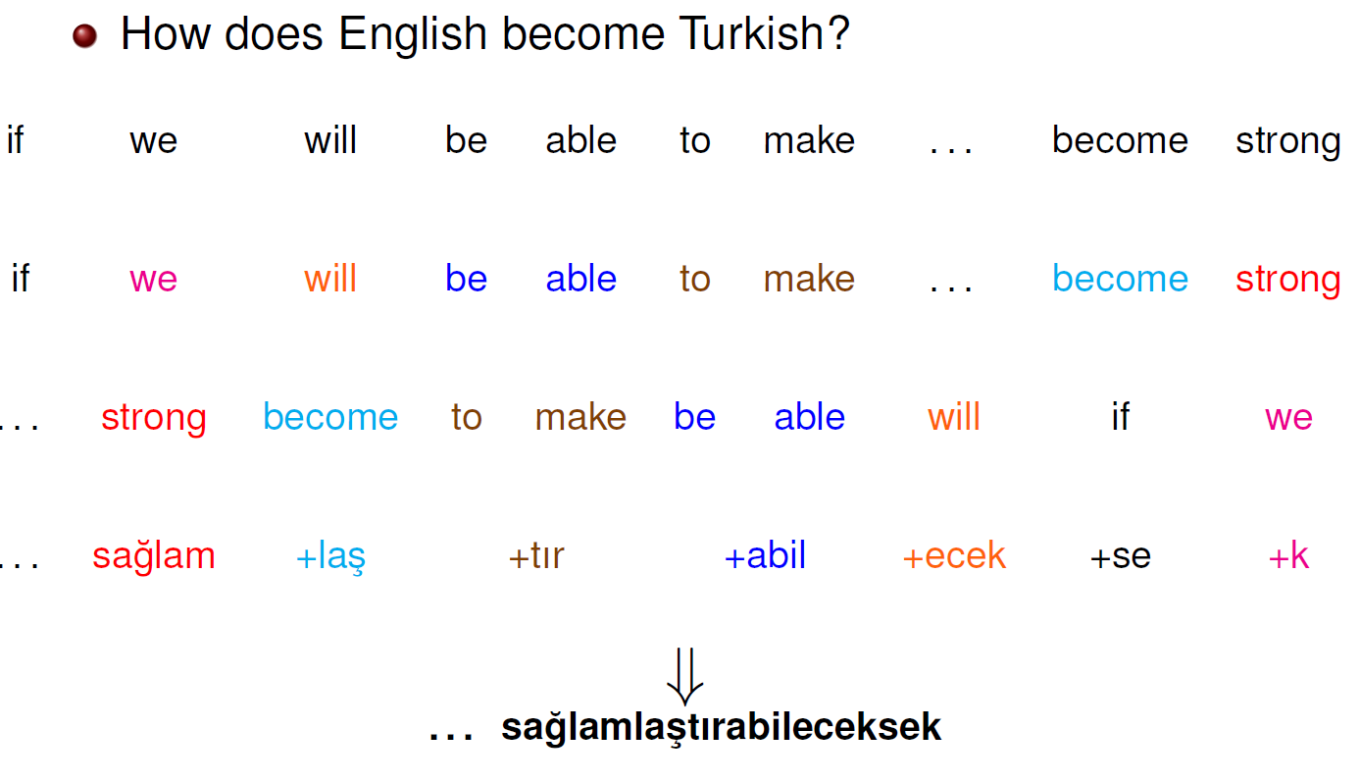
Agglutinative Languages
Slide from Kemal Oflazer
Notes:
Used with permission

Slide 12
Turkish Vowel Harmony
 | Front |  | Back
 | Unrounded | Rounded | Unrounded | Rounded
High | i | ü | ı | u
Low | e | ö | a | o
Back vowels
in the room → odada
at the door → kapıda
Front vowels
at home → evde
at the lake → gölde
on the bridge → köprüde
Notes:
http://webspace.ship.edu/cgboer/morphology.html

Slide 13
NACLO Problem
Turkish
www.nacloweb.org/resources/problems/2010/F.pdf
by Bozhidar Bozhanov

Slide 14
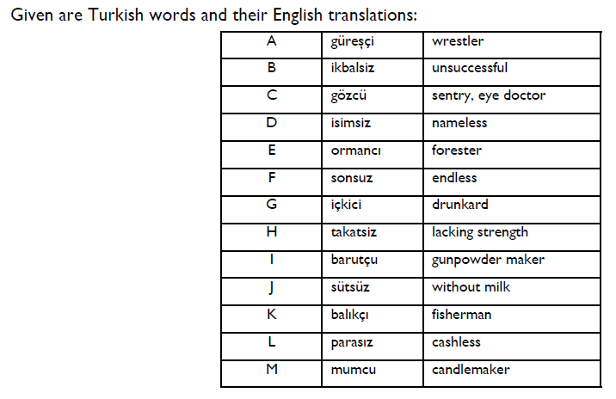

Slide 15
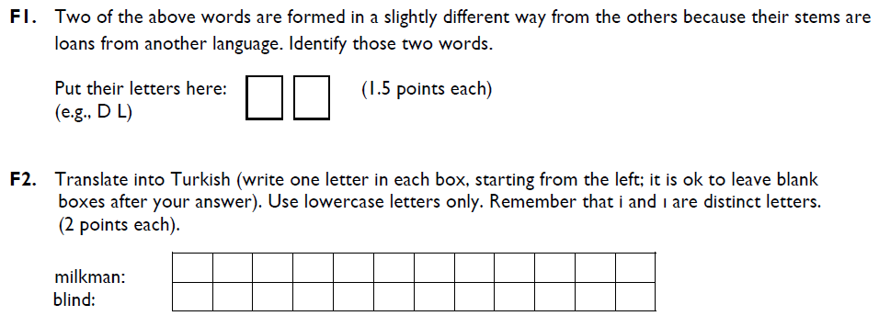

Slide 16
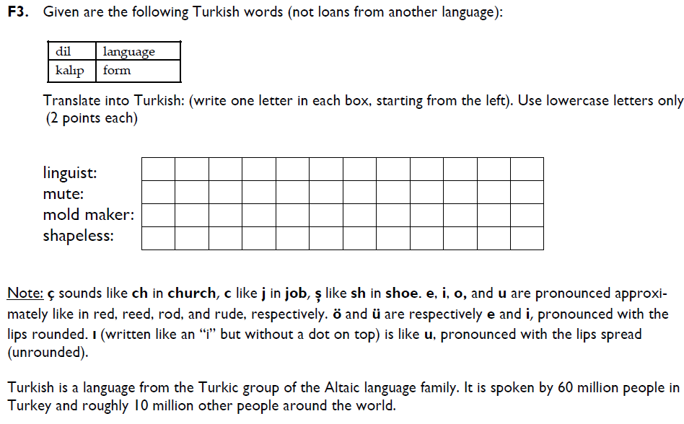

Slide 17
NACLO Solution
Turkish
www.nacloweb.org/resources/problems/2010/FS.pdf

Slide 18
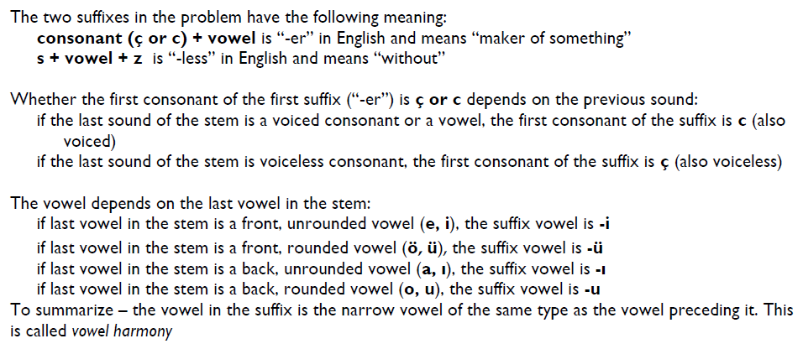

Slide 19
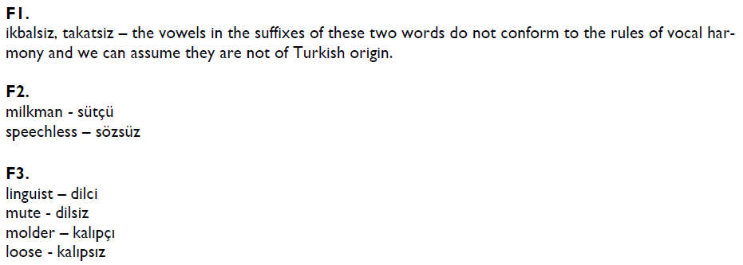

Slide 20
アメフト amefuto Ame(rican) Foot(ball)
アイスクリーム aisu kurīmu ice cream
アイドル aidoru idol
アパート apāto apartment
バイク baiku bike
バリアフリー bariafurī barrier free
コンピューター konpyūtā computer
デスク desuku desk (at a news agency)
ラマ dorama drama (on TV)
エレベーター erebētā elevator
エスカレーター esukarētā escalator
フライドポテト furaidopoteto fried potato (French fries)
グラス gurasu glass (for drinking)
ハッピーエンド happīendo happy end(ing)
ホットケーキ hottokēki hotcake (pancake)
カシューナッツ kashū nattsu cashew nut
コーヒー kōhī coffee
クラブ kurabu club
キーボード kībōdo keyboard
キャンペーン kyanpēn campaign
キャップ kyappu cap
パソコン pāsokon perso(nal) com(puter)
パーソナルコンピューターpāsonaru konpyūtā personal computer
レジュメ rejume resume
レストラン resutoran restaurant
リモコン rimokon remo(te) con(trol)
サラダ sarada salad
タバコ tabako tobacco
テレビゲーム terebigēmu television game
ゼミナール zemināru seminar
Notes:
MOVE

Slide 21
Introduction to NLP
Other Levels of Linguistic Analysis

Slide 22
Semantics
Semantics
Lexical semantics and compositional semantics
Lexical Semantics
Hypernyms, hyponyms, antonyms, meronyms and holonyms (part-whole relationship, tire is a meronym of car), synonyms, homonyms
Senses of words, polysemous words
Collocations
white hair, white wine
Idioms
to kick the bucket
Compositional Semantics
How to understand the meaning of a sentence based on the meaning of its components.

Slide 23
Pragmatics
The study of how knowledge about the world and language conventions interact with literal meaning.
Speech acts
Resolution of anaphoric relations
Modeling of speech acts in dialogue

Slide 24
Other Areas of Linguistics
Sociolinguistics
interactions of social organization and language.
Historical linguistics
change over time.
Linguistic typology
Language acquisition
L1 and L2
Psycholinguistics
real-time production and perception of language

Slide 25
NLP

